Slide 1
WRAP Regional Haze Planning Workgroup (RHPWG)
Shared Database Subcommittee
Video Teleconference
June 14, 2018 10a.m. (MDT)
Shawn McClure, CSU-CIRA

Slide 2
Presentation Outline
CIRA status report
Why CIRA?
Overview of the CIRA Air Quality System
Database Framework
Web Framework
Software Framework
Hardware Framework
Architectural details of the CIRA AQS
Websites that leverage the CIRA AQS
Intermountain West Data Warehouse (IWDW)
Southeastern Modeling, Analysis, and Planning (SEMAP)
Federal Land Manager Environmental Database (FED)
WRAP Technical Support System (TSS)
Tour of the new (and very DRAFT) TSS v2 website

Slide 3
CIRA Status Report
Acquired the TSS v1 code from ARS and recreated the development environment
Identified all the dashboards and products from the TSS v1
Created a beginning website framework for the TSS v2 website
Migrated several key air quality tools to the TSS v2 website
Began hosting the IMPROVE Data Analysis Tool from Ramboll
Investigated and compared several charting frameworks
Implemented the first draft of a WRAP Event Scheduling tool
Updated several key monitoring datasets
Summary: Progress continues in parallel with planning efforts

Slide 4
Why CIRA?
We’ve done similar projects in the past (including the TSS v1)
We have an extensive technology infrastructure to leverage
We maintain one of the largest air quality databases available
We’re familiar with the SIP and TIP development process
We’re collocated with the NPS Air Quality Research Group
We’re longtime and long-term collaborators with WESTAR/WRAP
We’re the primary source for all IMPROVE data and derived datasets
We’re very interested and invested in improving air quality
Summary: Most of the key TSS infrastructure is already in place

Slide 5
CIRA Air Quality System Overview
Database
Web
Software
Hardware
CIRA Air Quality System

Slide 6
Relational database:
Almost 1 billion records
62 air quality monitoring networks
5 dozen water quality projects
24 modeling and satellite datasets
A growing emissions data inventory
Database
Web
Software
Hardware
Database
Import/Update
Management
Administration
Dissemination
File database:
~150 Terabytes of online data
~100 Terabytes of offline data
~85 Terabytes downloaded/transferred
~500 TB current storage capacity
7 complete modeling platforms
CIRA Air Quality System
Monitoring Datasets:
IMPROVE (and special studies)
IMPROVE RHR and Impairment
AQS (Almost every dataset)
CASTNET (Dry deposition, O₃)
NADP (NTN, AIRMoN, MDN, Derived)
USFS Water Quality
more…

Slide 7
Websites:
WRAP TSS
IWDW
IMPROVE
FED
NPSCAT
SEMAP
VIEWS
Web
Visualization tools
Analysis tools
Mapping tools
Query & retrieval tools
Web services
Software
Hardware
Web
Database
Service Consumers:
FETS
DataFed
UNC
Ramboll
ESIP
NPS
CIRA Air Quality System

Slide 8
Database
Web
Hardware
Software
Code base:
Microsoft .NET Framework
Custom query management framework
Custom data visualization framework
Custom air quality analysis libraries
Optimized graphics generation library
Parameterized chart customization API
CIRA Air Quality System
Software
Data access libraries
Data transformation tools
Web delivery framework
Data analysis tools
Specialized Tools:
ESRI ArcGIS
Interactive Data Language (IDL)
Statistical Analysis System (SAS)
MATLAB
Mathematica
ENVI

Slide 9
Database
Web
Software
Hardware
CIRA Air Quality System
Hardware
Server configuration
Server maintenance
Networking
Troubleshooting & repair
Physical Infrastructure:
Fifteen Windows servers
Three 8U Linux file servers
Onsite sys-admin and service
99.9% Internet up-time
University-sized fiber optic Internet “pipe”
Internal data throughput of +1000 GB/s

Slide 10
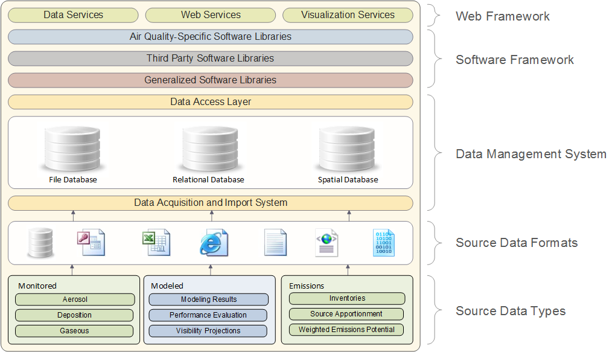
CIRA Air Quality System Overview
CIRA Air Quality System Details
Database
Web
Software
Hardware
CIRA Air Quality System

Slide 11
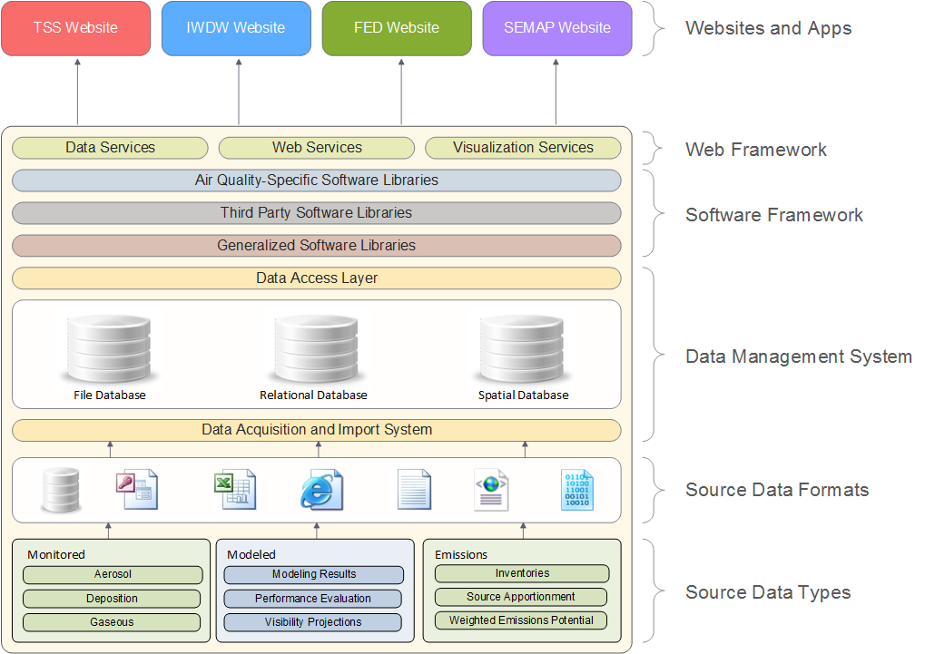

Slide 12
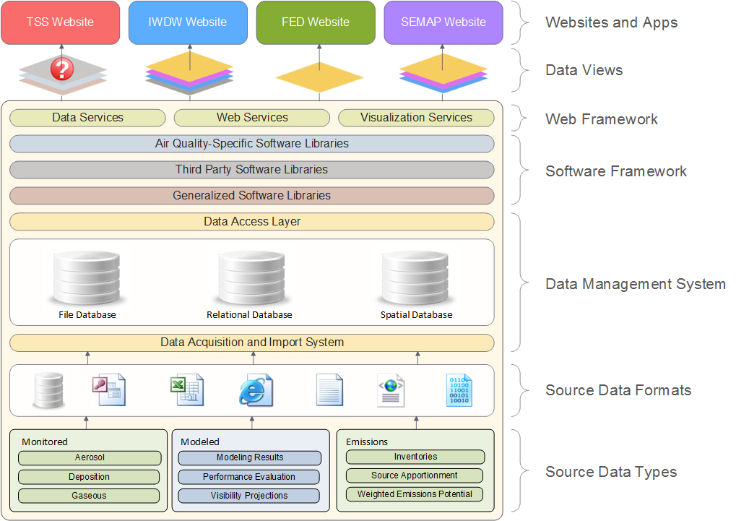

Slide 13
WRAP
Technical Support System
(TSSv2)
Partners: WRAP States, WESTAR
Intermountain West
Data Warehouse
(IWDW)
Partners: NPS, BLM, USFS, EPA, CO, WY, UT, NM
Databases
Web
Software
Hardware
CIRA Air Quality System
Federal Land Manager
Environmental Database
(FED)
Partners: NPS, USFS
Southeastern
Modeling, Analysis, and Planning System
(SEMAP)
Partners: EPA, AL, FL, GA, KY, MS, NC, SC, TN

Slide 14
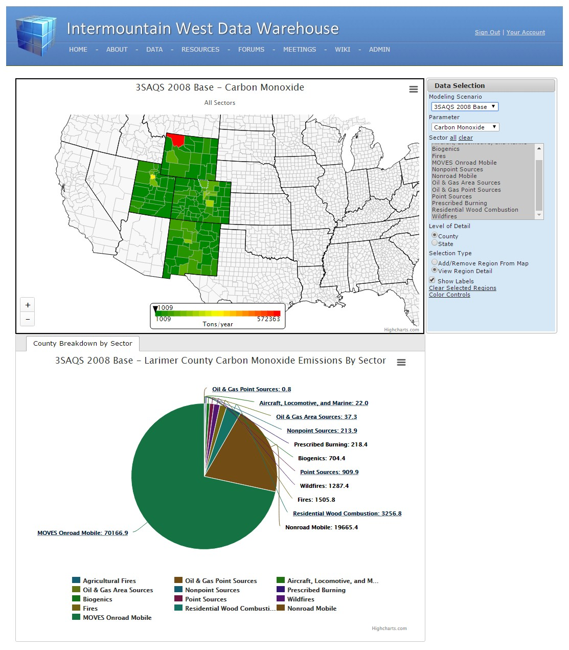
WRAP
Technical Support System
(TSSv2)
Partners: WRAP States, WESTAR
Intermountain West
Data Warehouse
(IWDW)
Partners: NPS, BLM, USFS, EPA, CO, WY, UT, NM
Database
Website
Software
Hardware
Provides:
Select air quality monitoring datasets
Derived IMPROVE datasets (RHR, Imp.)
WAQS modeling input platforms
WAQS modeling results
Air quality summary tools
Model performance evaluation tools
Model-to-obs comparison tools
Emissions review tools
CIRA Air Quality System
Federal Land Manager Environmental Database
(FED)
Partners: NPS, USFS
Southeastern
Modeling, Analysis, and Planning
(SEMAP)
Partners: AL, FL, GA, KY, MS, NC, SC, TN
Filters Out:
Non-western states (data and tools)
Non-WAQS modeling inputs and results
IMPROVE special studies
USFS water quality data
NPS-specific ozone metrics
http://views.cira.colostate.edu/iwdw

Slide 15
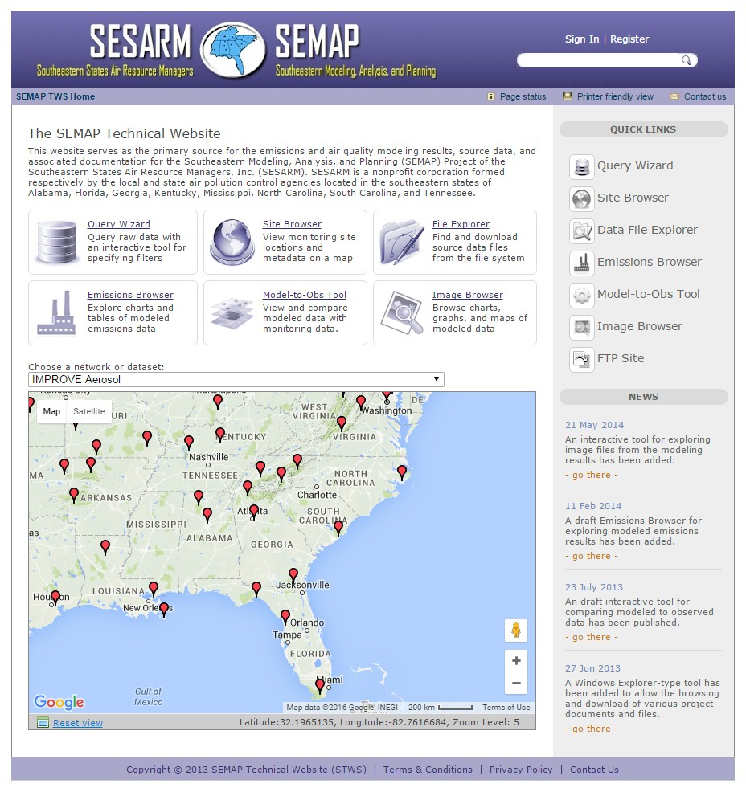
WRAP
Technical Support System
(TSSv2)
Partners: WRAP States, WESTAR
Intermountain West
Data Warehouse
(IWDW)
Partners: NPS, BLM, USFS, EPA, CO, WY, UT, NM
Provides:
Select air quality monitoring datasets
Derived IMPROVE datasets (RHR, Imp.)
Air quality summary tools
Model performance evaluation tools
Model-to-obs comparison tools
Database
Web
Software
Hardware
Filters Out:
Non-SEMAP states (data and tools)
Non-SEMAP modeling inputs and results
IMPROVE special studies
USFS water quality data
NPS-specific ozone metrics
CIRA Air Quality System
Federal Land Manager Environmental Database
(FED)
Partners: NPS, USFS
Southeastern
Modeling, Analysis, and Planning
(SEMAP)
Partners: EPA, AL, FL, GA, KY, MS, NC, SC, TN
http://views.cira.colostate.edu/semap

Slide 16
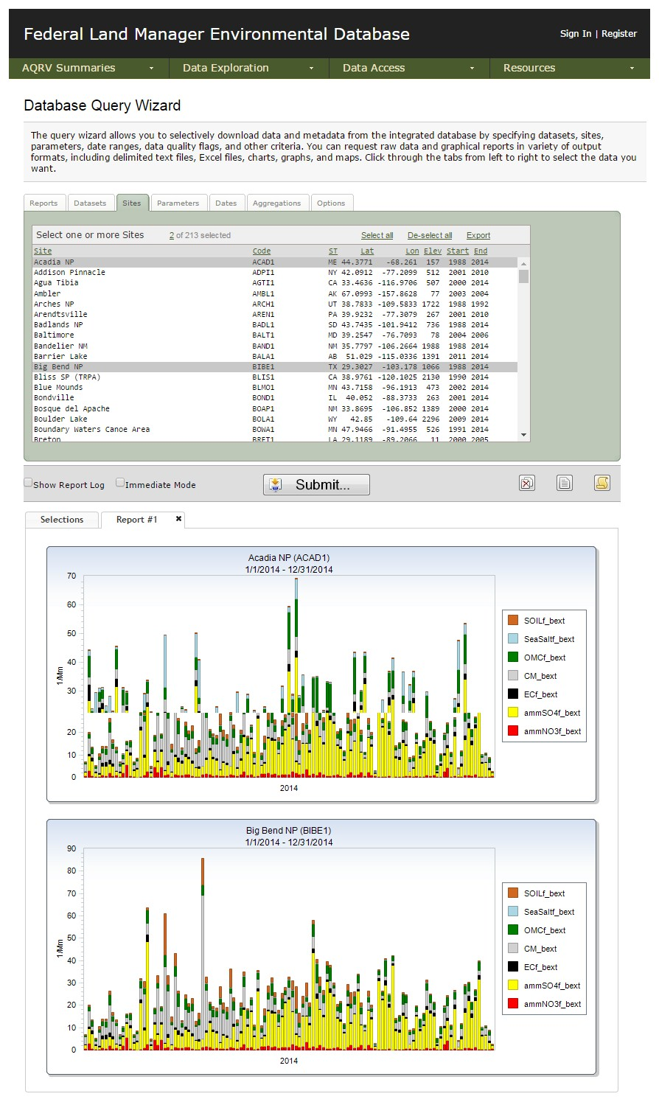
Provides:
All raw air quality monitoring datasets
All IMPROVE special studies
Derived IMPROVE datasets (RHR, Imp.)
NPS-specific ozone metrics
All USFS water quality data
Unrestricted geographical area
WRAP
Technical Support System
(TSSv2)
Partners: WRAP States, WESTAR
Intermountain West
Data Warehouse
(IWDW)
Partners: NPS, BLM, USFS, EPA, CO, WY, UT, NM
Database
Web
Software
Hardware
Filters Out:
All modeling inputs and results
CIRA Air Quality System
Federal Land Manager
Environmental Database
(FED)
Partners: NPS, USFS
Southeastern
Modeling, Analysis, and Planning
(SEMAP)
Partners: AL, FL, GA, KY, MS, NC, SC, TN
http://views.cira.colostate.edu/fed

Slide 17
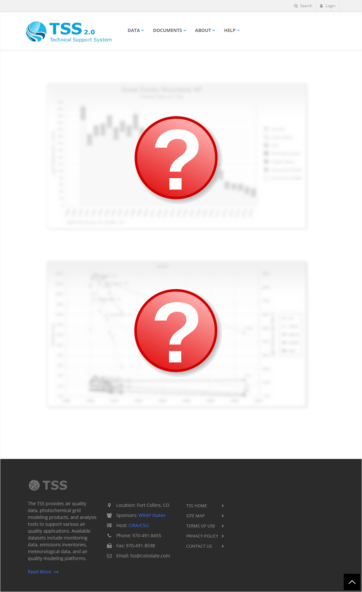
WRAP
Technical Support System
(TSSv2)
Partners: WRAP States, WESTAR
Intermountain West
Data Warehouse
(IWDW)
Partners: NPS, BLM, USFS, EPA, CO, WY, UT, NM
Database
Web
Software
Hardware
Provides (??):
Select AQ planning snapshots
New derived IMPROVE datasets (TBD)
Regional haze planning tools
Model performance evaluation tools
Visibility projection tools
Emissions review tools
CIRA Air Quality System
Federal Land Manager Environmental Database
(FED)
Partners: NPS, USFS
Southeastern
Modeling, Analysis, and Planning
(SEMAP)
Partners: AL, FL, GA, KY, MS, NC, SC, TN
Filters Out (??):
All “living” air quality monitoring datasets
All “living” derived datasets
IMPROVE special studies
NPS-specific ozone metrics
Most non-WRAP data
http://views.cira.colostate.edu/tss

Slide 18
TSS Website Tour
A now for a brief tour of the new (and very DRAFT) TSS v2 website…
http://views.cira.colostate.edu/tssv2

Slide 19
Short-term Development Roadmap
Finish updating all the relevant air quality monitoring datasets
Finish recreating the original TSSv1 development environment (for reference in developing new queries and products)
Add the user authentication framework to the TSSv2 website
Integrate key air quality summary tools into the TSSv2
Set the initial “data view” to be used by the TSSv2 tools
Add the new WRAP Event Management System to the TSSv2
Work with the RHPWG to understand the various sorting algorithms, views, and derived datasets that need to be considered in regard to designing products for the IMPROVE Impairment dataset

Slide 20
TSS Glidepaths – examples
Pat Brewer

Slide 21
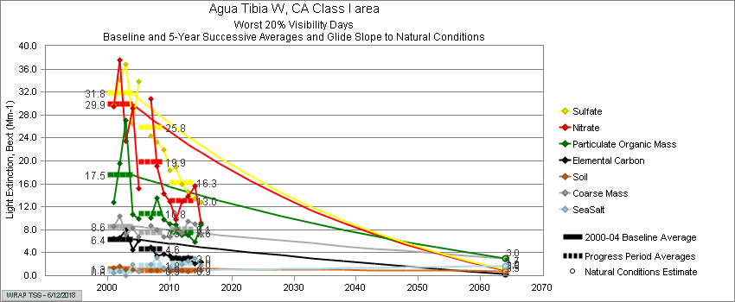
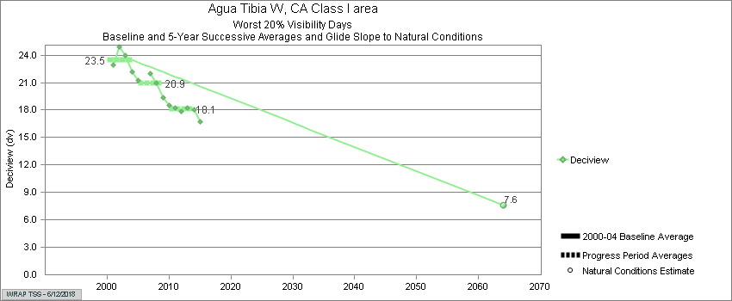
RHR required states to track visibility
progress on haziest days using deciview
metric.
Tracking light extinction of individual
aerosol species was useful to understand
which pollutants were contributing to
dv trend.
Sulfate, nitrate, and particulate organic mass are most important contributors to trend at Aqua Tibia, reflecting
urban influence

Slide 22
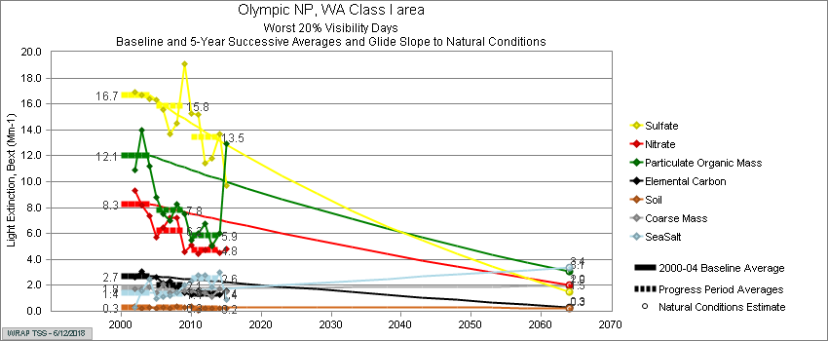
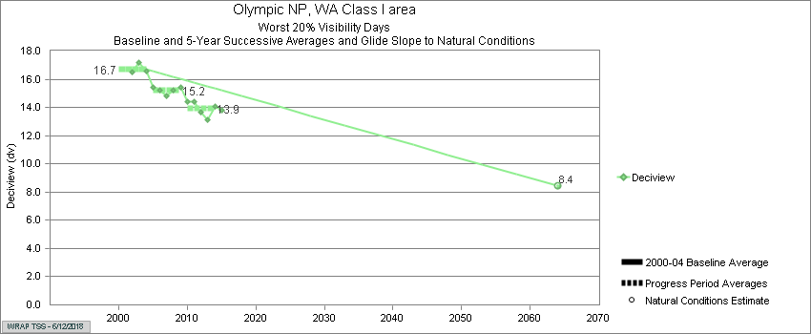
Sulfate dominates at Olympic. Source attribution suggests local industry, marine shipping, Canada, and international transport contribute.

Slide 23
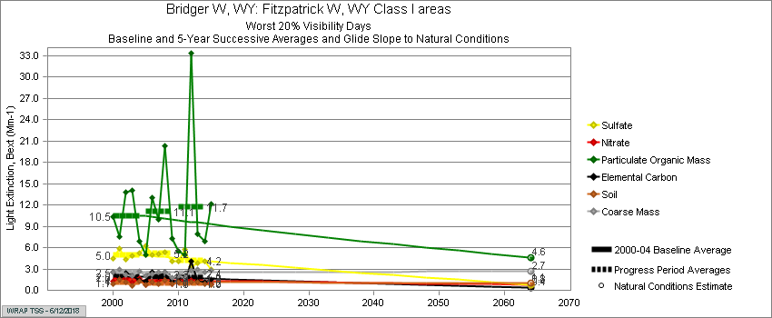
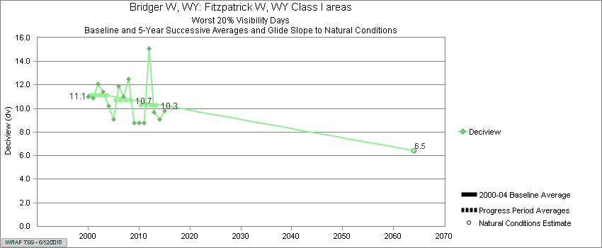
Particulate Organic Mass appears
to be elevated in years above URP

Slide 24
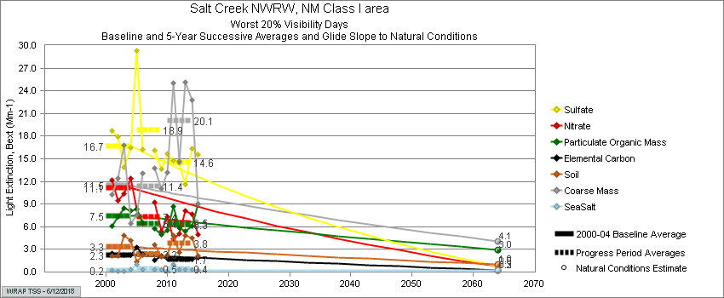
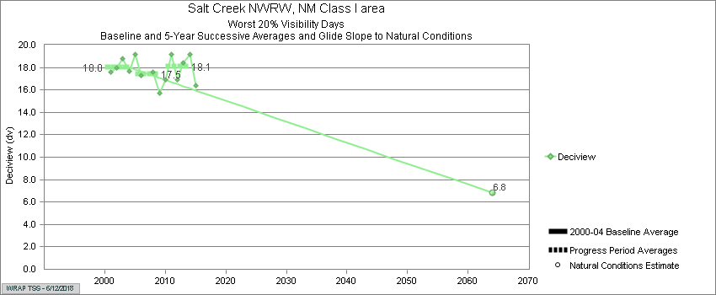
Coarse mass appears to be
elevated in years above URP

Slide 25
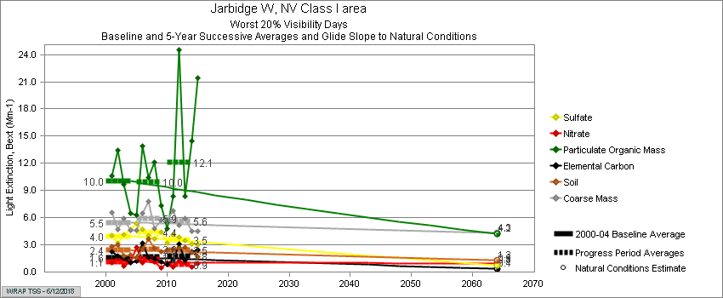
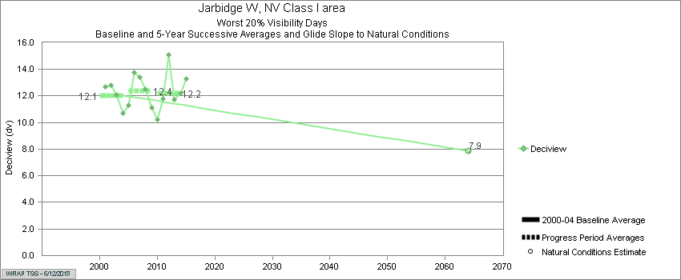

Slide 26
For TSS2, glidepaths should display most impaired days
Early draft
example plot

